Slide 1
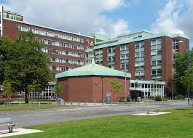
Out of Hours Safety Induction for the Schuster Building. UG students only
Dr Nicola Hutchings
School Safety Coordinator and Advisor

Slide 2

Fire Alarm
The fire alarm in Schuster is a one stage alarm. This means it will continuously ring.
On hearing the fire alarm you should evacuate the building immediately.
The alarms are tested (continuously for 15 seconds) every:-
Wednesday at 9:15 am in Schuster Building.

Slide 3

Fire - evacuation
When you are leaving:
Do not use the lifts.
Use the nearest exit.
Close windows and doors behind you.
OUT OF HOURS there will be no fire marshals present.
Assembly point for Schuster Building is on Brunswick Park Avenue.
Do not re-enter the building until Emergency Services/University Security say it is safe to do so.

Slide 4

Refuge
If you are unable to leave the building unaided go to the designated refuge points situated in the stairwells.
Press the intercom and wait for assistance. Or ring security on 69966 and let them know your location.
If you have a disability which will effect your evacuation please contact the School Safety Coordinator and Advisor e.g. may be long term or on crutches.
An Personal Emergency Evacuation Plan – PEEPS will be created for you.

Slide 5
Fire – OUT OF HOURS
Know your contacts:-
Emergency Services 9-999
University Security internal 69966 (The number is on the back of your card).
If you have rang for an ambulance, police or fire engine, you MUST ring security straight afterwards so they can quickly direct them to correct place.
Learn your evacuation routes.

Slide 6
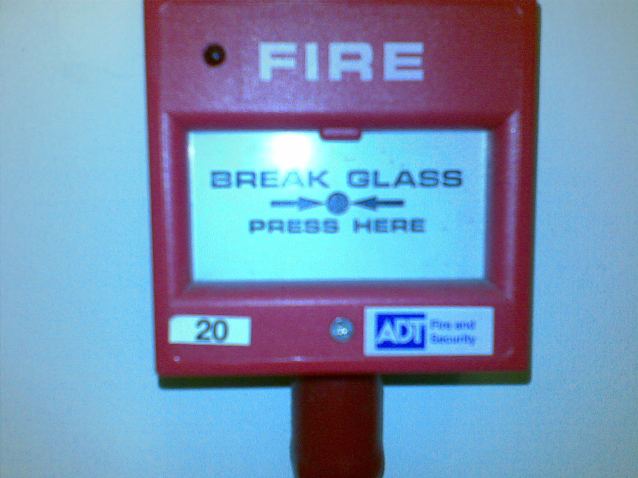
Fire – raising the alarm
Raising the alarm
Break the glass – located on all exit routes.
Call Fire Service 9-999 if safe to do so.
Leave and stay out.

Slide 7
First Aid
Available in the event of an accident or sudden illness.
If you are on campus and unwell outside of normal working hours, you can ring security the number is on the back of your university card - 69966. They are all trained first aiders and carry their own kits, they will get to you within a few minutes.
In an emergency, please use the first aid box and welfare facilities in room B.50 (in basement by the main stairwell).
A defibrillator is located in the foyer of the Schuster building.
Notes:
Describe details of the School’s first aid arrangements
Students with health problems/disabilities encourage them to tell their supervisor so that they can ensure appropriate assistance is available
Also can use this time to remind students that they will need to ensure they are registered with a GP as Occ Health doesn’t provide general primary care facilities

Slide 8
Accident, incident & near-miss reporting
If an near-miss, incident or accident occurs out of hours please contact Security on 69966.
Please report this the next working day to a responsible person (i.e. admin office or School Safety Advisor).
Notes:
Describe what is meant by each of the terms
Accident – involving personal injury
Incident – no personal injury
Near Miss – could have resulted in an accident/incident
Cartoon – shows an accident, if he’d landed on his feet uninjured it should have been reported as a fall from height - near miss!
Describe school arrangements for accident/ incident/ near miss reporting
Encourage reporting no matter how trivial; they feel it is

Slide 9

Safety
Contact Security if:-
You notice anyone acting suspiciously
You feel threatened
You witness damage to a piece of equipment
Someone has tailgated (followed you) in to the building.
You are allowed in the Annexe ground floor breakout area, library L6, Annexe quiet study area room 2A.03, student common room L4 or mezzanine computer clusters only, this is for your own safety.
If you are found to be disobeying the rules your access may be rescinded.

Slide 10
Safety Contacts
Nicola Hutchings– School Safety Coordinator Advisor – Nicola.Hutchings@manchester.ac.uk – Ext. 54088
Alan Wardle – Deputy Safety Advisor – alan.wardle@manchester.ac.uk – Ext 54079

